Slide 1
Protein Family Classification
MS. Umberto Di Fabrizio

Slide 2
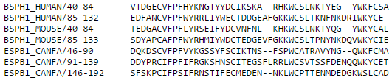
Purpose
Classify proteins accordingly to their family.
PROTEIN NAME
PROTEIN SEQUENCE
PROTEIN FAMILY
Fibronectin type-II 1
http://prosite.expasy.org/PS51092#TP

Slide 3
Outline
Why protein classification?
How to compare sequences?
ANN - Pros & Cons
Pipeline
Data preprocessing
Data collection
Implementation
Backpropagation
Convolutional Neural Network
Results

Slide 4
Why protein classification?
PURPOSE: Preventing genetic disease, drug discovery, medical diagnosis.
PROBLEM: Experiments are costly and slow thus they cannot keep pace with the amount of information available and which needs to be annotated.
CLUE: Similar protein sequences exhibit almost the same biological function.

Slide 5
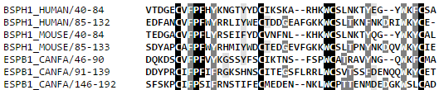
How to compare sequences?

Slide 6
ANN Pros&Cons
Can extract hidden patterns (motif)
BUT
How to encode Letters?
Different length of sequences?
Missing data?

Slide 7
Data Preprocessing
Exploit NLP techniques:
For each protein sequence, analyze the frequency of bigrams.
Normalize the count of bigrams on the length of the sequence
 | A | C | T | G
A | 0 | 1 | 1 | 0
C | 1 | 0 | 1 | 0
T | 0 | 0 | 0 | 2
G | 0 | 1 | 1 | 0
Seq= ACTGTGCAT
Number of inputs? length(Seq)^2
In our case (20+3)^2=529 inputs

Slide 8



Data Collection
DOWNLOAD 600 PROTEIN NAMES FOR FAMILY
FROM WWW.PROSITE.EXPASY.ORG
GET PROTEIN SEQUENCE BY NAME FROM WWW.UNIPROT.ORG
SPLIT DATA IN
TRAIN SET(90%) AND
TEST SET (10%)
USE NLTK LIBRARY TO CALCULATE BIGRAM FREQUENCY

Slide 9

Backpropagation
Y1
Y2
Y3
Y4
529 INPUTS
FULLY CONNECTED
FULLY CONNECTED
6 NEURONS
5 NEURONS
4 NEURONS
4 FAMILIES:
0001
0010
0100
1000
LEARNING RATE:
[0.1-1.5]
TOTAL WEIGHTS: 529*6+6*5+5*4=3224

Slide 10
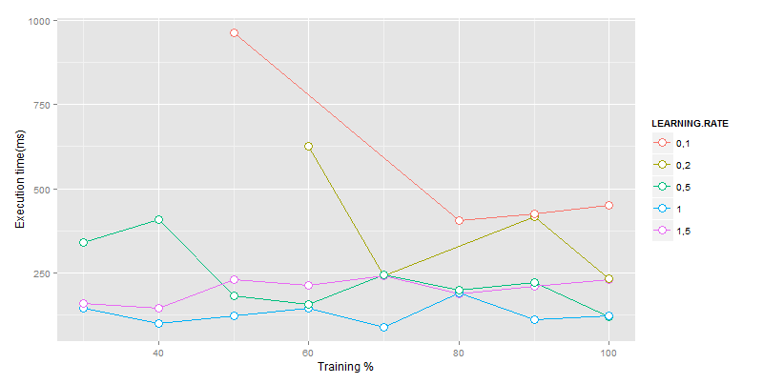
BackProp Results: 95%
Training: 70% = 1512 inputs
Epochs: 5
Execution time: 98(ms)

Slide 11

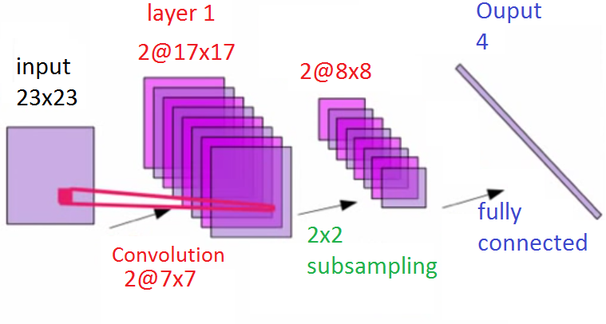
Convolutional NN: 95%
EPOCHS: [1,5]
LEARNING RATE: [0.01,0.03,0.05]
FEATURE MAPS: [2,3]
TRAINING % = 70
TOTAL WEIGHTS: 2*7*7+2*2*2+64*2*4=618
EXECUTION TIME: 669(ms)

Slide 12
Future Work
Evaluate the performances of the LAMSTAR

Slide 13

Questions?

